Slide 1
Food Truck Sales & Marketing System
Systems Analysis and Design Project
Team Members: Jalen Yates, Michael Duffy, and Jermaine Koger
Course: CST-385
Instructor: Dr. Park
🍴 Food Truck System • Freshly Designed for Customers 🍔
Notes:
Welcome the audience. Introduce your project team and provide context for the course and instructor.

Slide 2
Project Overview
Goal: Build a system to manage food truck operations: sales, orders, marketing, reporting.
Stakeholders:
- Business Owner
- Employees
- Customers
Core Features:
- Online orders
- Inventory updates
- Promotions & customer engagement
🍴 Food Truck System • Freshly Designed for Customers 🍔
Notes:
Explain the overall objective of your project: to create an integrated system to support a food truck business. Mention the key stakeholders and core features.

Slide 3
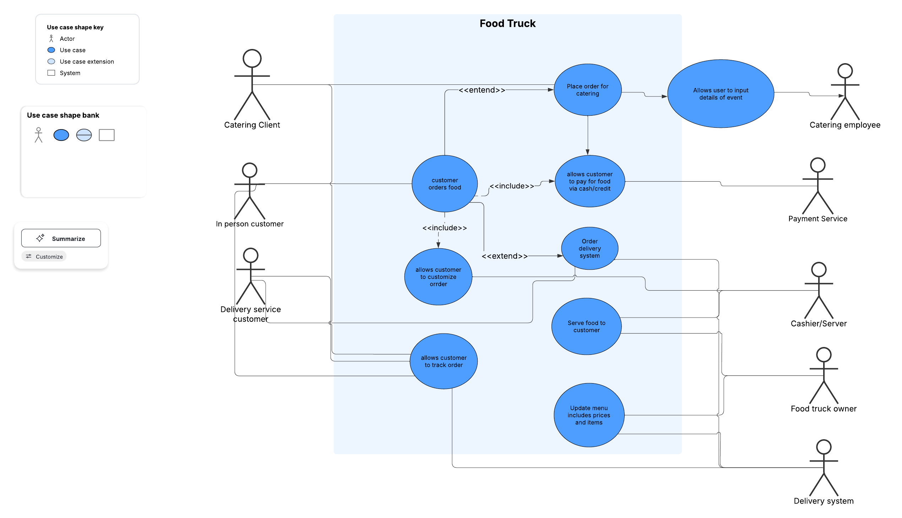
Use Case Diagram
🍴 Food Truck System • Freshly Designed for Customers 🍔
Notes:
Walk through the use case diagram. Point out the actors (users) and what actions they can perform in the system.

Slide 4
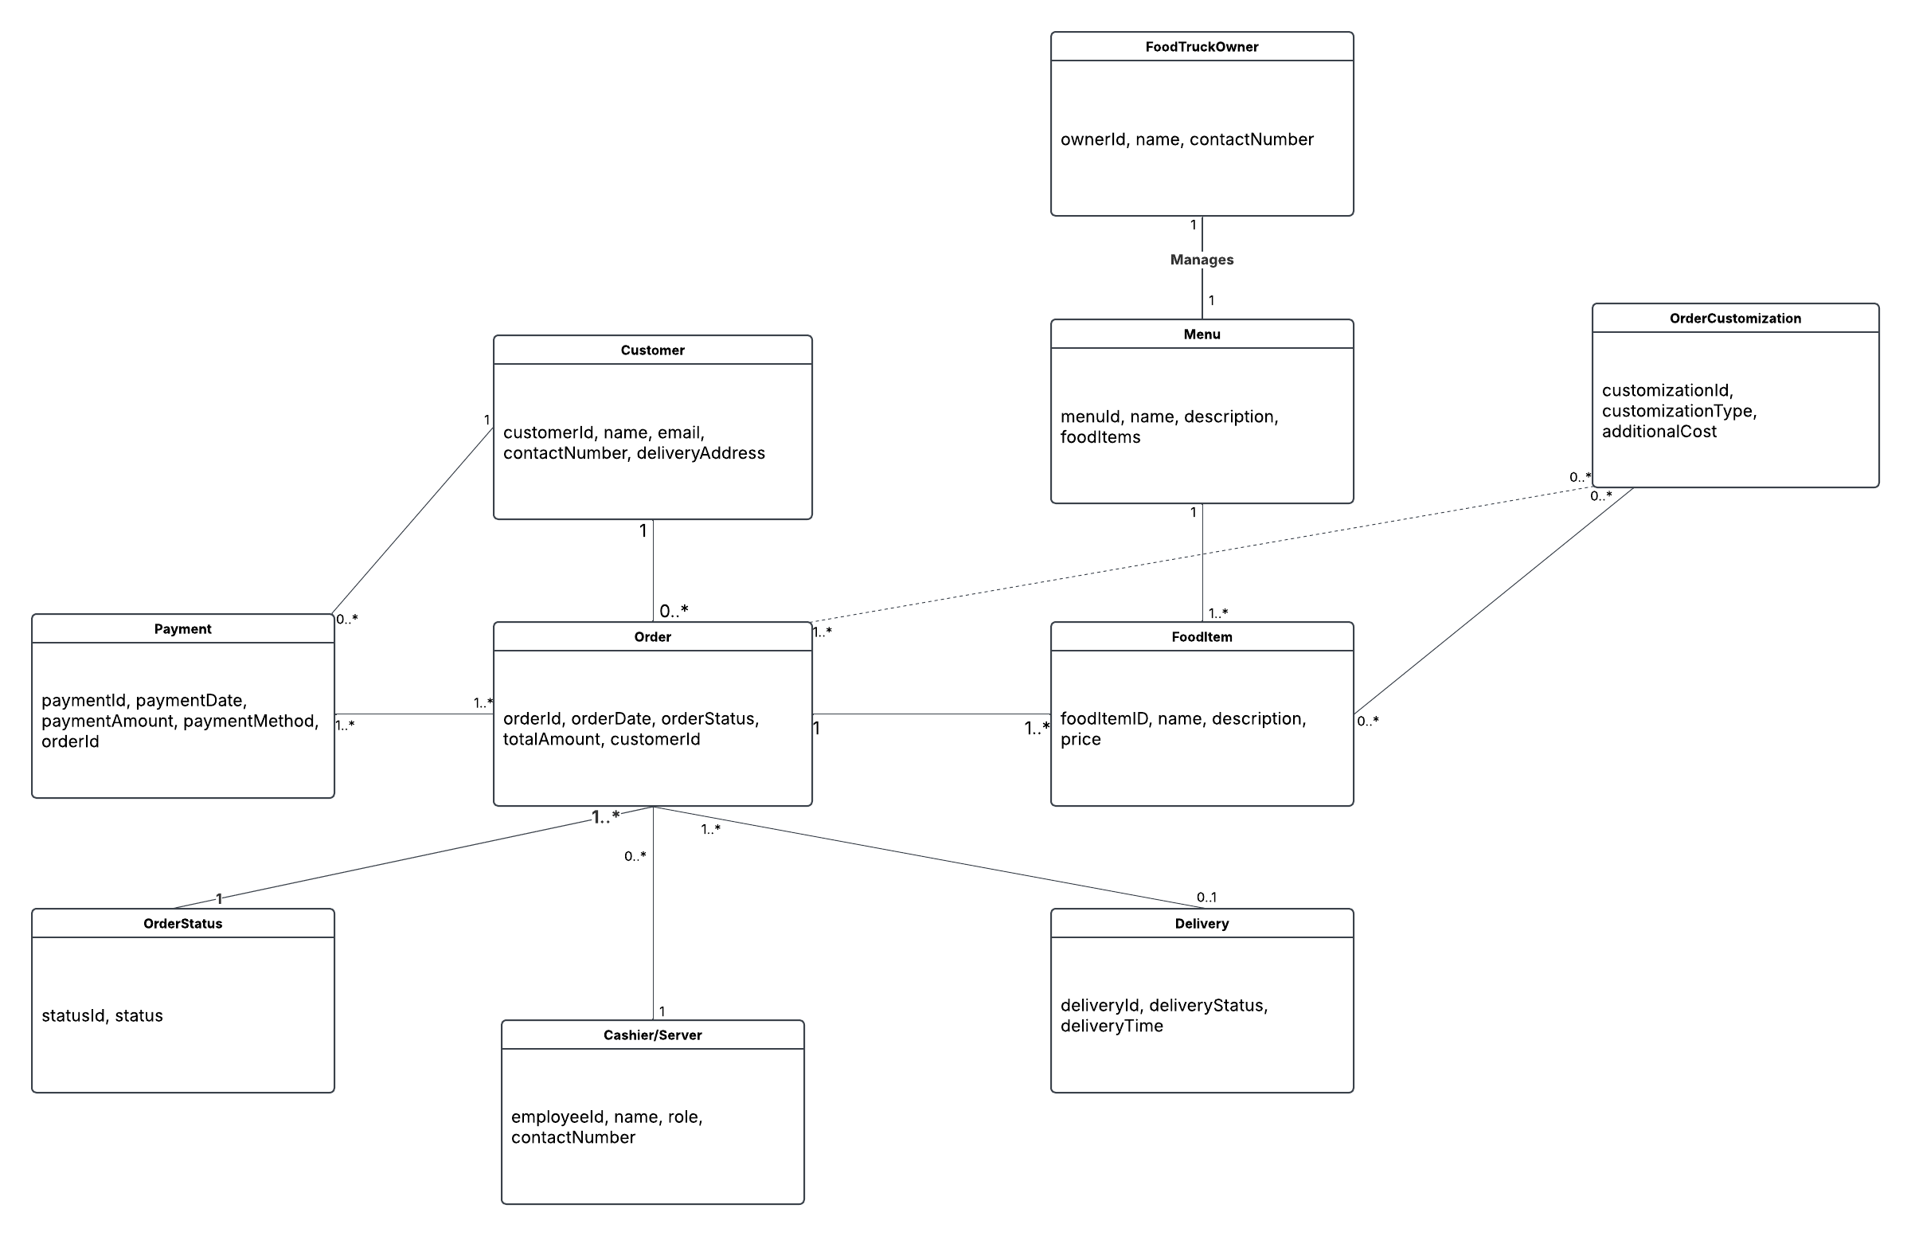
Domain Model Class Diagram
🍴 Food Truck System • Freshly Designed for Customers 🍔
Notes:
Discuss the domain model class diagram. Explain how different data objects relate, such as orders, customers, and menu items.

Slide 5
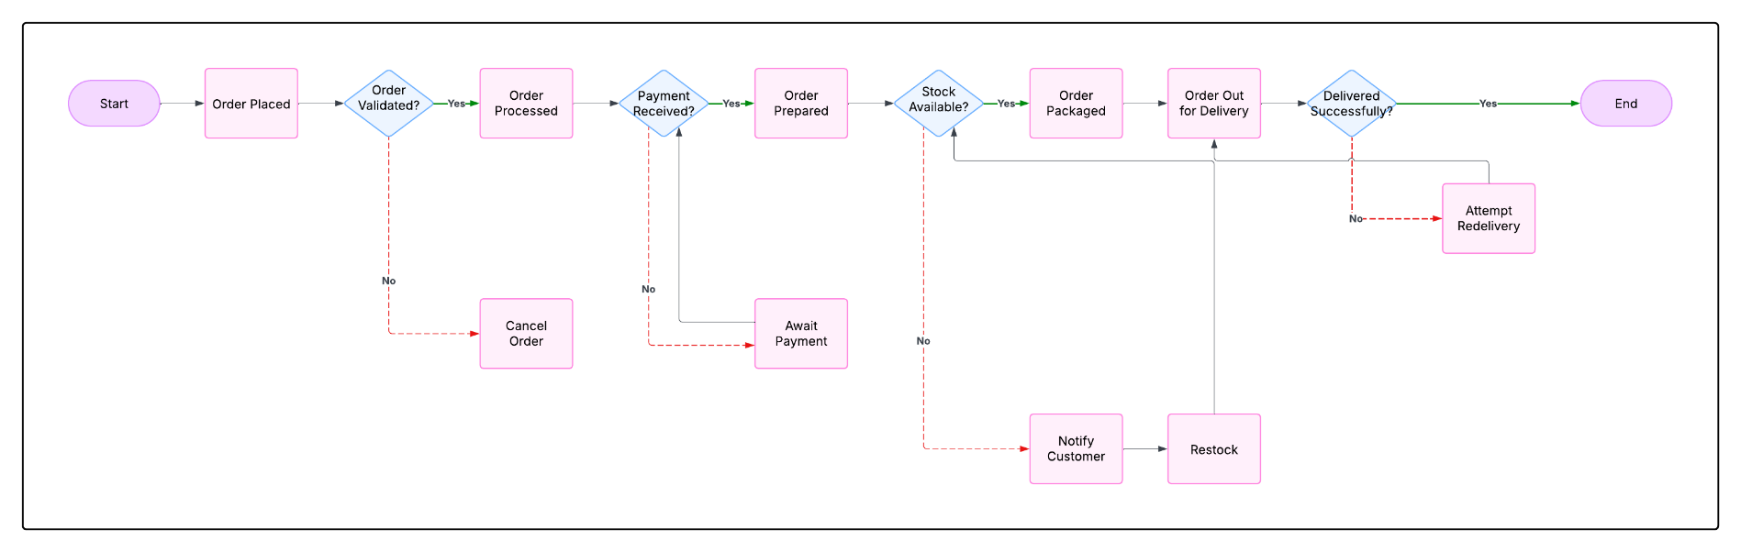
System Sequence Diagram
🍴 Food Truck System • Freshly Designed for Customers 🍔
Notes:
Describe the system sequence diagram. Emphasize the step-by-step interaction between the user and the system when placing an order.

Slide 6
System Architecture
3-Tier Architecture:
- UI Layer: Mobile/Web Interface
- App Layer: Order processing, Marketing
- Data Layer: MySQL/SQLite
🍴 Food Truck System • Freshly Designed for Customers 🍔
Notes:
Present the system architecture. Describe the three layers (UI, App, Data) and what responsibilities each holds.

Slide 7
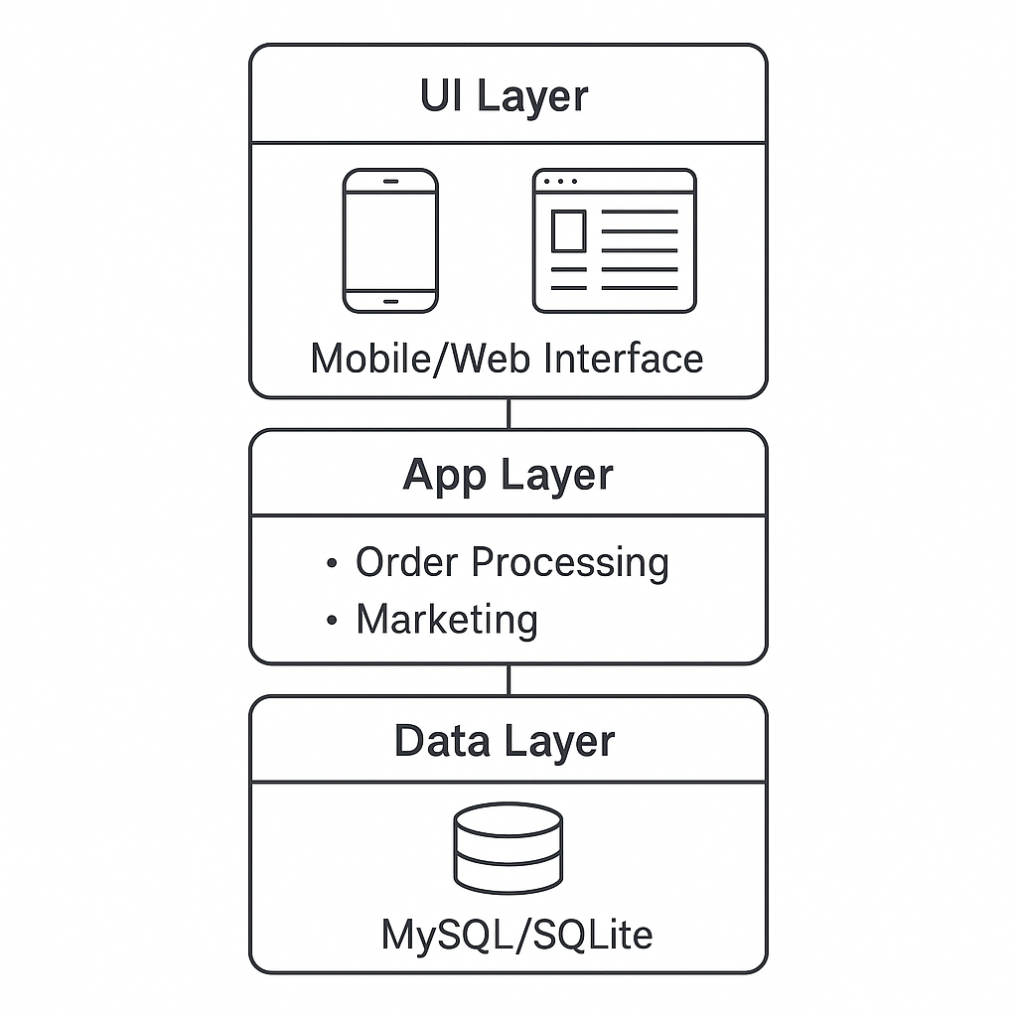
Architecture Diagram
Notes:
UI Layer (User Interface) front-end that customers interact with. includes our mobile app or website where users can browse the menu and place orders. The focus is on making it easy and intuitive for customers to use.
App Layer (Application Logic) the brain of our system. It handles tasks like processing customer orders, sending notifications, and running marketing campaigns. It connects the interface with the data, making sure everything flows smoothly behind the scenes.
Data Layer (Database) stores everything – menu items, customer info, orders, and more. We’re using MySQL. It keeps our data organized and accessible to the application layer.

Slide 8
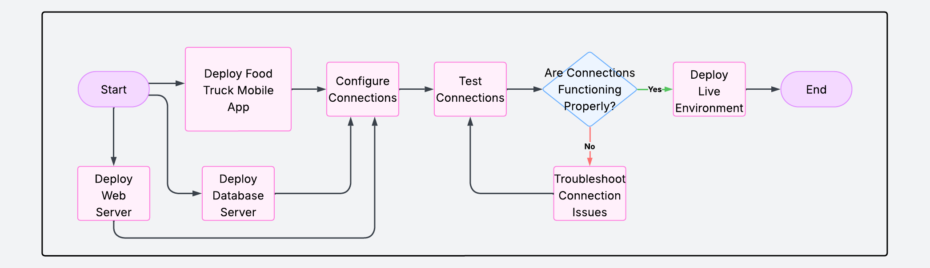
Deployment Diagram
🍴 Food Truck System • Freshly Designed for Customers 🍔
Notes:
Use the deployment diagram to explain how the system is physically distributed and accessed by different users.

Slide 9
UI Screens
Implementation and mockups -
- Customer Order Form: Menu selection, order summary
- Employee Dashboard: Order queue, status update
- Owner Panel: Sales report, manage promotions
🍴 Food Truck System • Freshly Designed for Customers 🍔
Notes:
Talk through the UI mock-ups. Show how customers place orders, employees track them, and owners manage business operations.

Slide 10
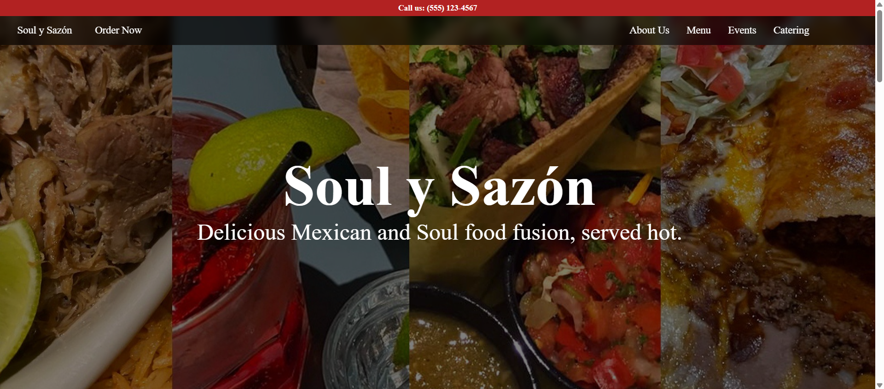
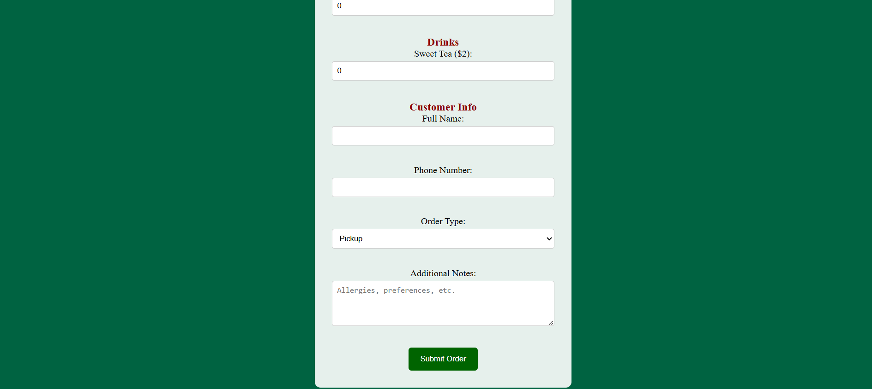
UI design

Slide 11
Database Schema
Tables:
- Orders(orderID, customerID, total, status)
- Customers(customerID, name, phone)
- MenuItems(itemID, name, price)
- Employees(empID, name, role)
🍴 Food Truck System • Freshly Designed for Customers 🍔
Notes:
Explain the database schema: what each table stores and how they are related. Point out primary keys and connections.

Slide 12
Test Plan Summary
Test Cases:
Place valid order | Input: Menu item + quantity | Output: Order confirmation
Cancel order | Input: Order ID | Output: Status = 'Canceled'
View report | Input: Date range | Output: PDF with totals
🍴 Food Truck System • Freshly Designed for Customers 🍔
Notes:
Review the test plan. Explain the types of test cases used and what the expected outputs demonstrate.

Slide 13
Team Contributions
All Members: Use case, system modeling
All Members: UI design, implementation
All Members: Database and test plan
All Members: Presentation and documentation
🍴 Food Truck System • Freshly Designed for Customers 🍔
Notes:
Highlight each team member’s contributions and how collaboration worked throughout the semester.

Slide 14

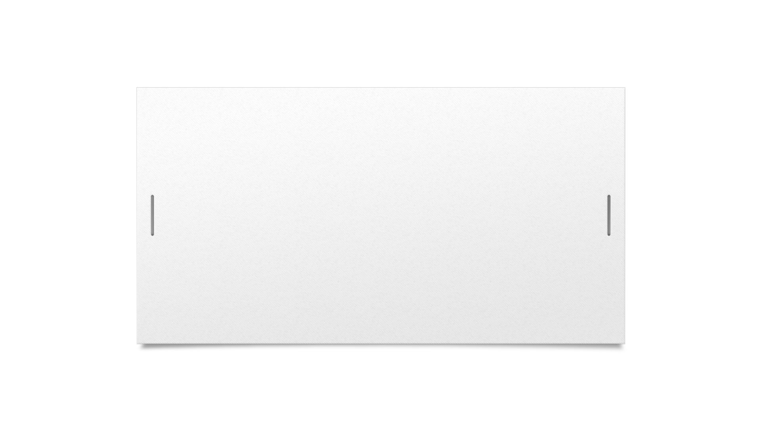




Demonstration

Slide 15
Next Steps
Develop the backend by using a database software to create an order table, customer accounts, menu items, etc.
Make the website scalable.
Better develop the catering section
Use JavaScript to make the webpage more dynamic and user friendly

Slide 16
Conclusion
Functional prototype built with core features
Full set of models (UML, DB schema, UI)
Solid foundation for full system deployment
Next Steps: Add analytics, integrate payment
🍴 Food Truck System • Freshly Designed for Customers 🍔
Notes:
Summarize the project results and mention what could be added in the future, like analytics or payment systems.

